Slide 1
Projection of points, lines
UNIT-II

Slide 2
Projection of points

Slide 3
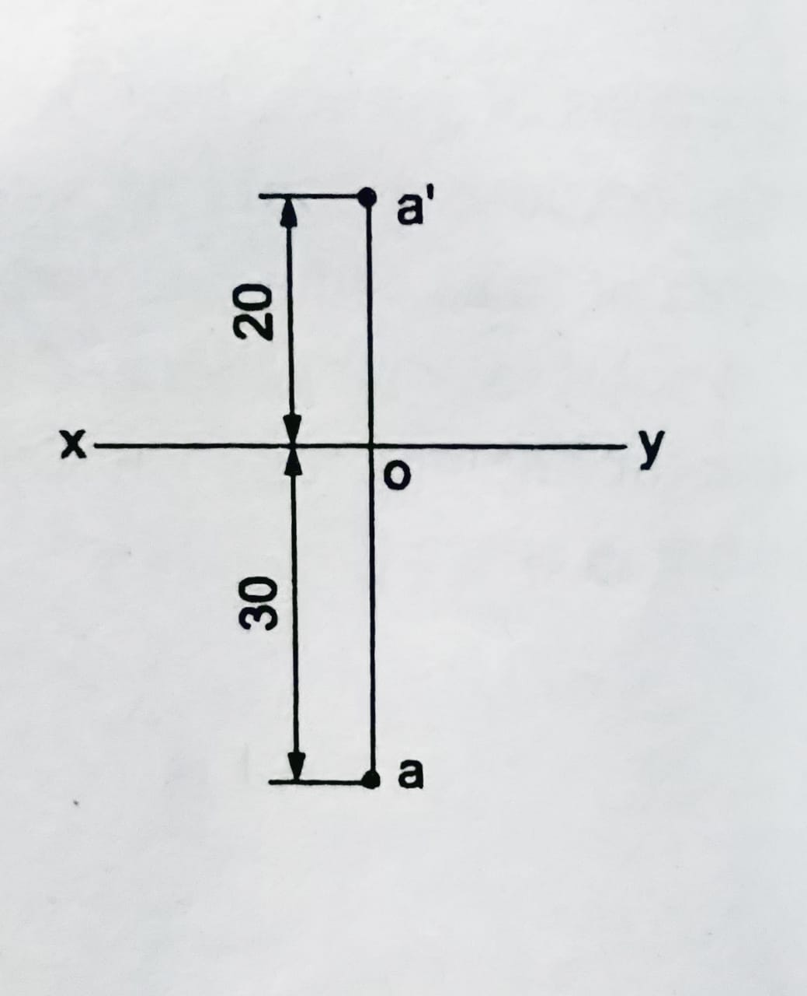
1. A point A is 20 above H.P and 30 in front of V.P. Draw the projections of the point.

Slide 4
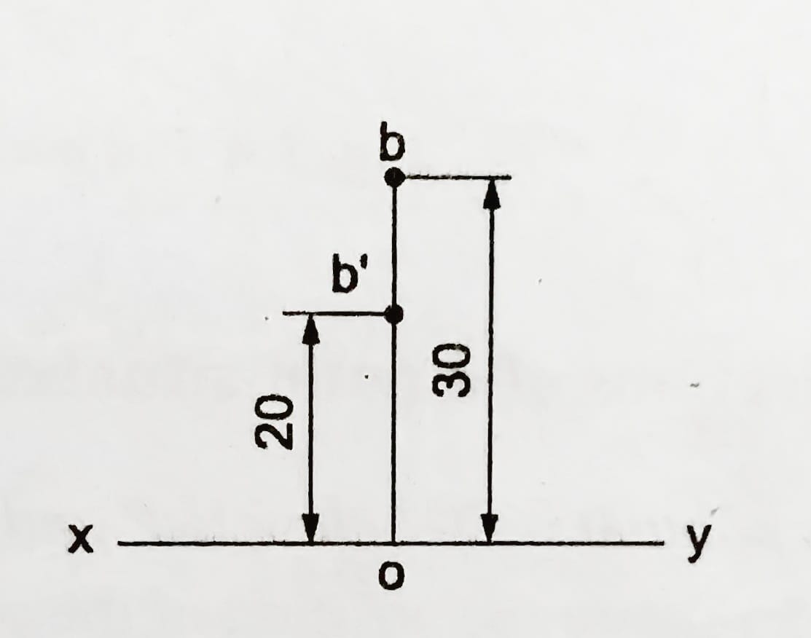
2. A point B is 20 above H.P and 30 behind V.P. Draw its projections.

Slide 5
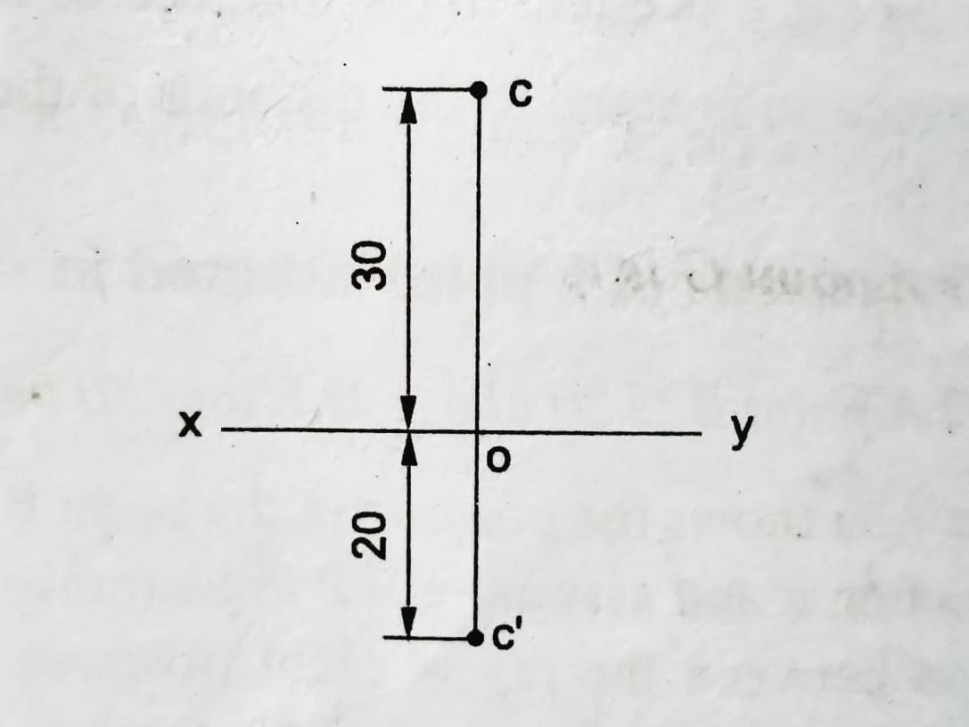
3. A point C is 20 below H.P and 30 behind V.P. Draw its projections.

Slide 6
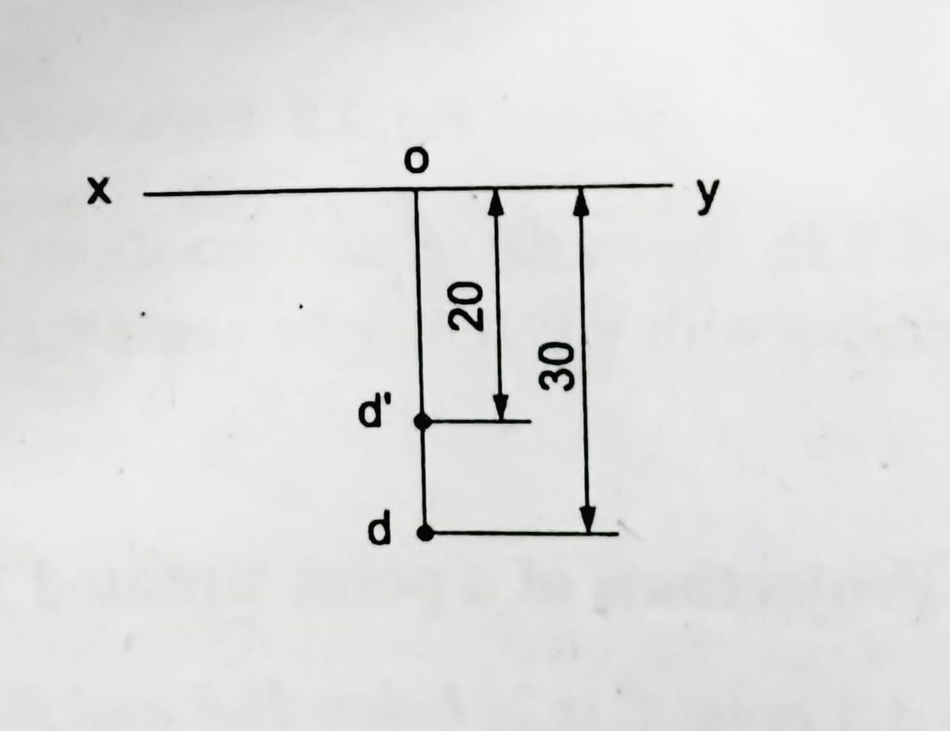
4. A point D is 20 below HP and 30 in front of V.P. Draw its projections.

Slide 7
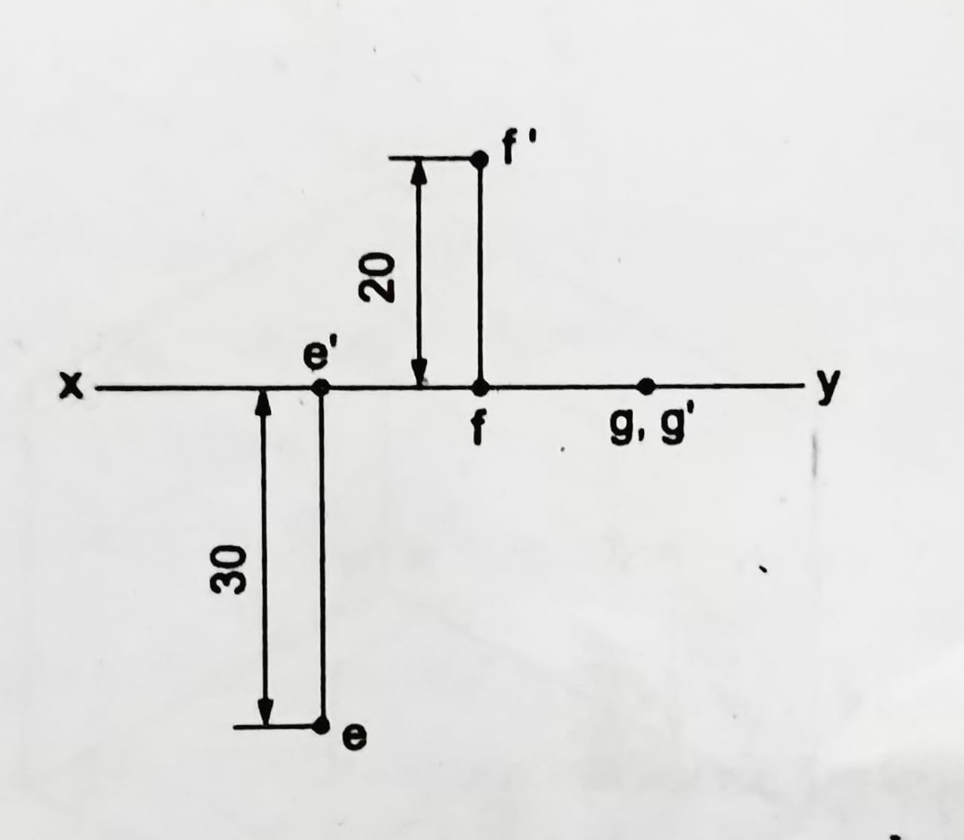
5. A point E is on H.P and 30 in front of V.P. Draw its projections. 6. A point F is on V.P and 20 above H.P. Draw its projections. 7. A point G is lying on both H.P and V.P. Draw its projections.

Slide 8
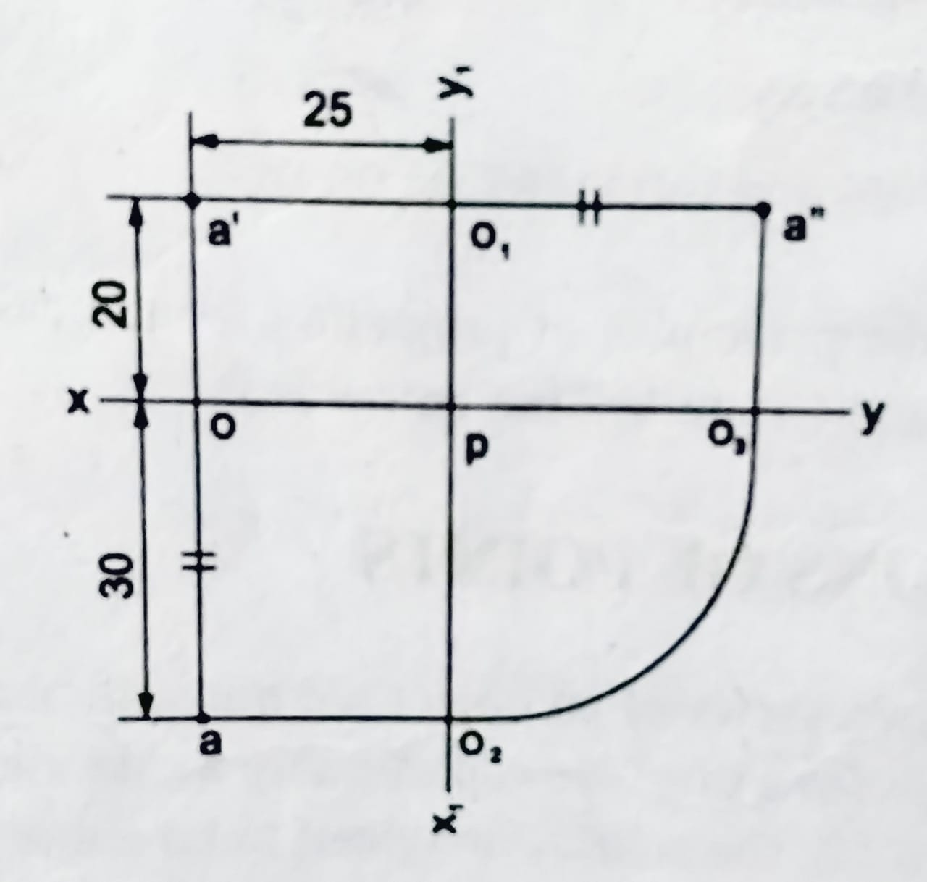
8. A point A is 20 above H.P, 30 in front of V.P and 25 in front of P.P. Draw (i) front view, (ii) top view and (iii) left side view of the point.

Slide 9
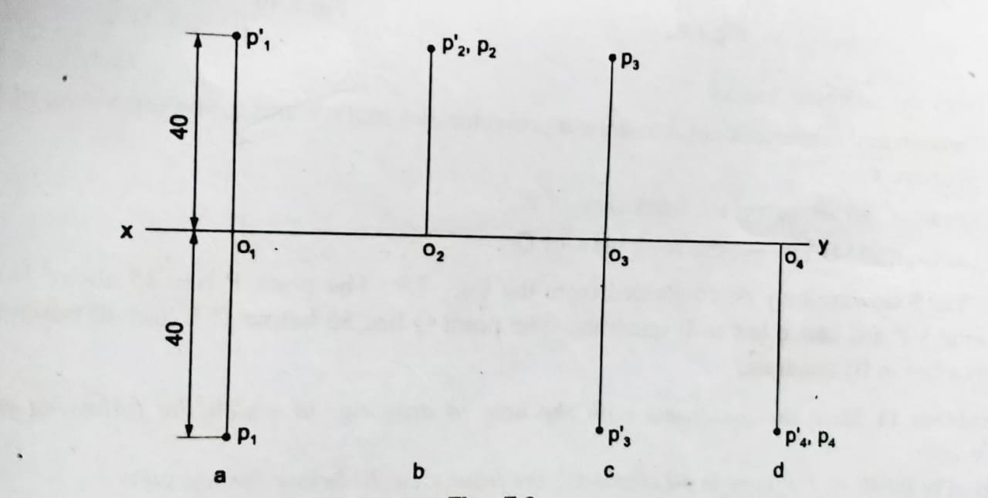
9. A point P is 40 from both the principal planes of projection. Draw its projections.

Slide 10
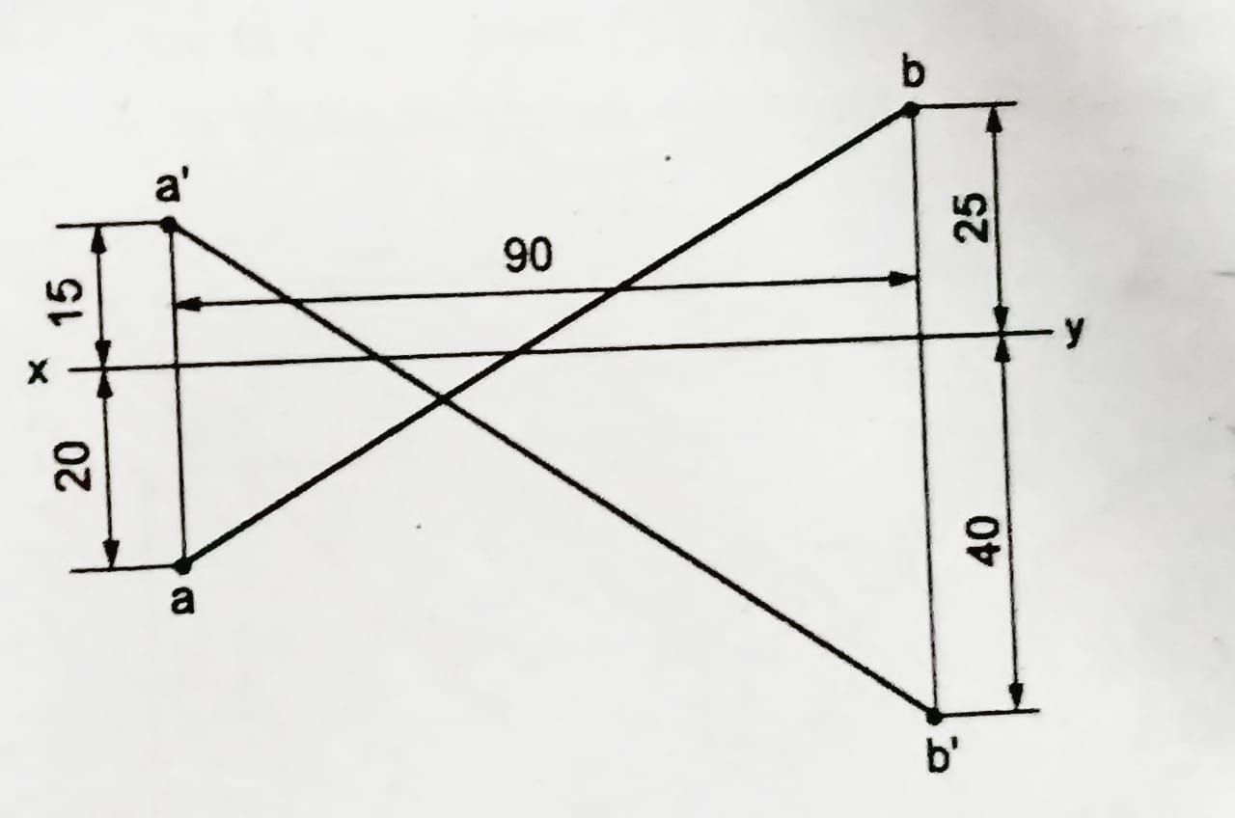
10. A point A is 15 above H.P and 20 in front of V.P. Another point B is 25 behind V.P and 40 below H.P. Draw the projections of A and B, keeping the distance between the projectors equal to 90. Draw straight lines, joining (i) the top views and (ii) the front views.

Slide 11
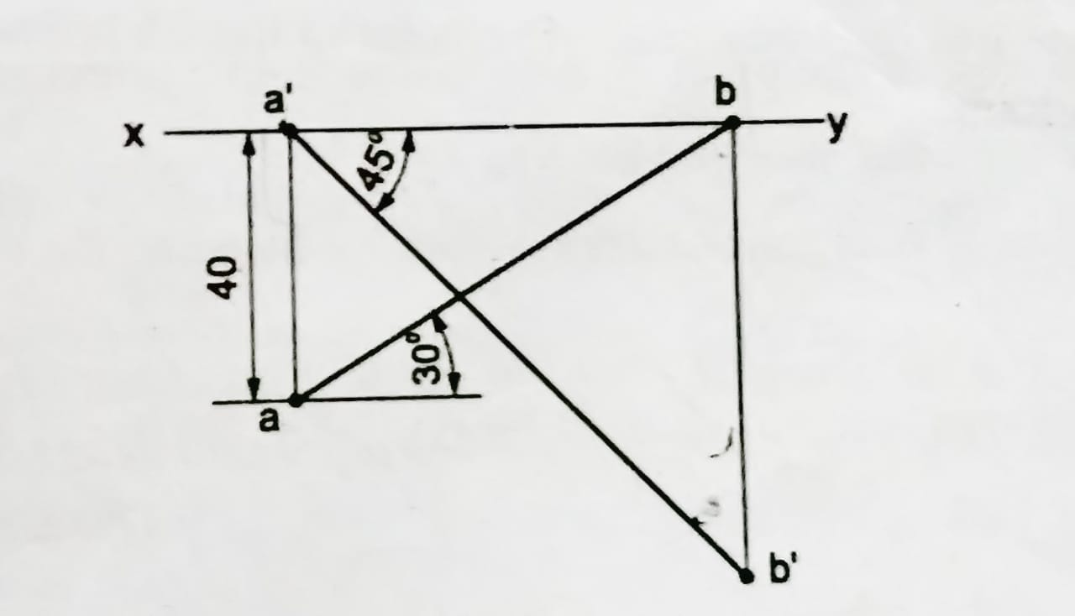
11. A point A is on H.P and 40 in front of V.P. Another point B is on VP and below H.P. The line joining their front views makes an angle of 45° with xy, while the line joining their top views makes an angle of 30°. Find the distance of the point B from H.P.

Slide 12
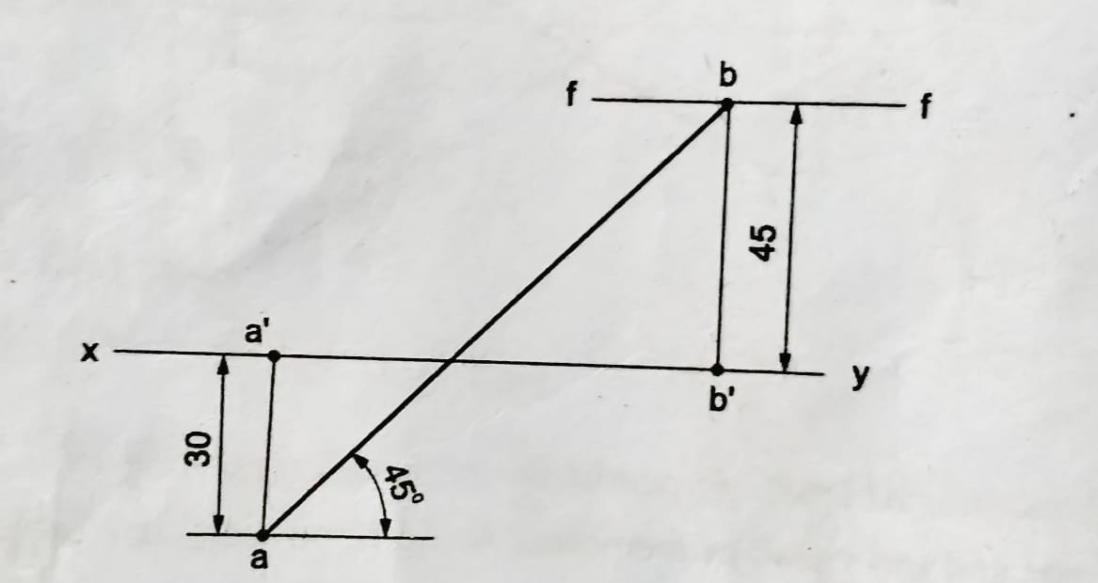
12. Two points A and B are on H.P; the point A being 30 in front of V.P. while B is 45 behind V.P. The line joining their top views makes an angle of 45° with xy. Find the horizontal distance between two points.

Slide 13
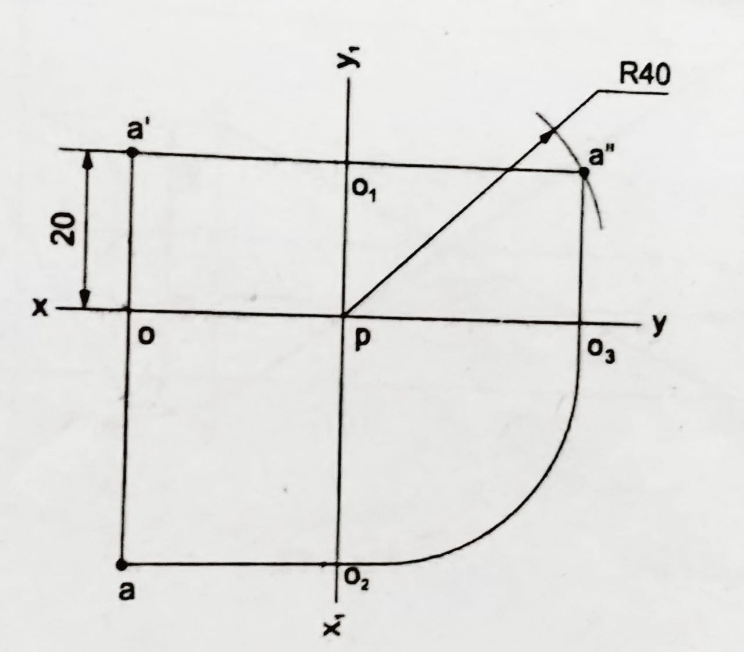
13. A point A is 20 above H.P and in the first quadrant. Its shortest distance from the reference line XY is 40. Draw the projections of the point and determine its distance from V.P.

Slide 14
14. Draw the projections of the following points, keeping the distance between the projectors as 25 on the same reference line.
A-25 above H.P and 45 in front of V.P.
B-35 above H.P and 50 behind V.P.
C-40 below H.P and 30 behind V.P.
D-30 below H.P and 40 in front of V.P.
E-50 above H.P and on V.P.
F-45 below H.P and on V.P.
G-on H.P and 35 in front of V.P.
H- on H.P and 25 behind V.P.
I- on both H.P and V.P.

Slide 15
Projection of lines

Slide 16
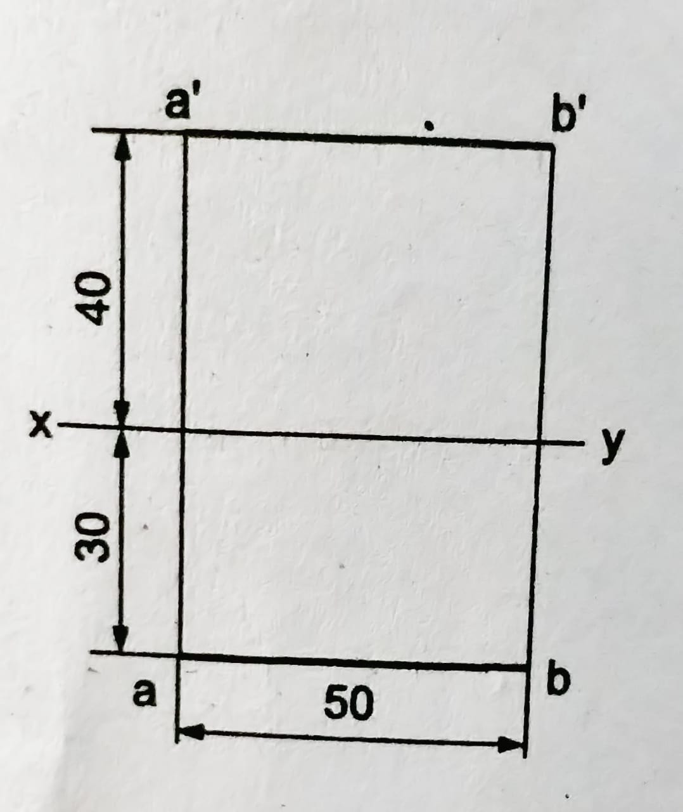
15. A line AB of 50 long, is parallel to both H.P and V.P. The line is 40 above H.P and 30 in front of V.P. Draw the projections of the line.

Slide 17
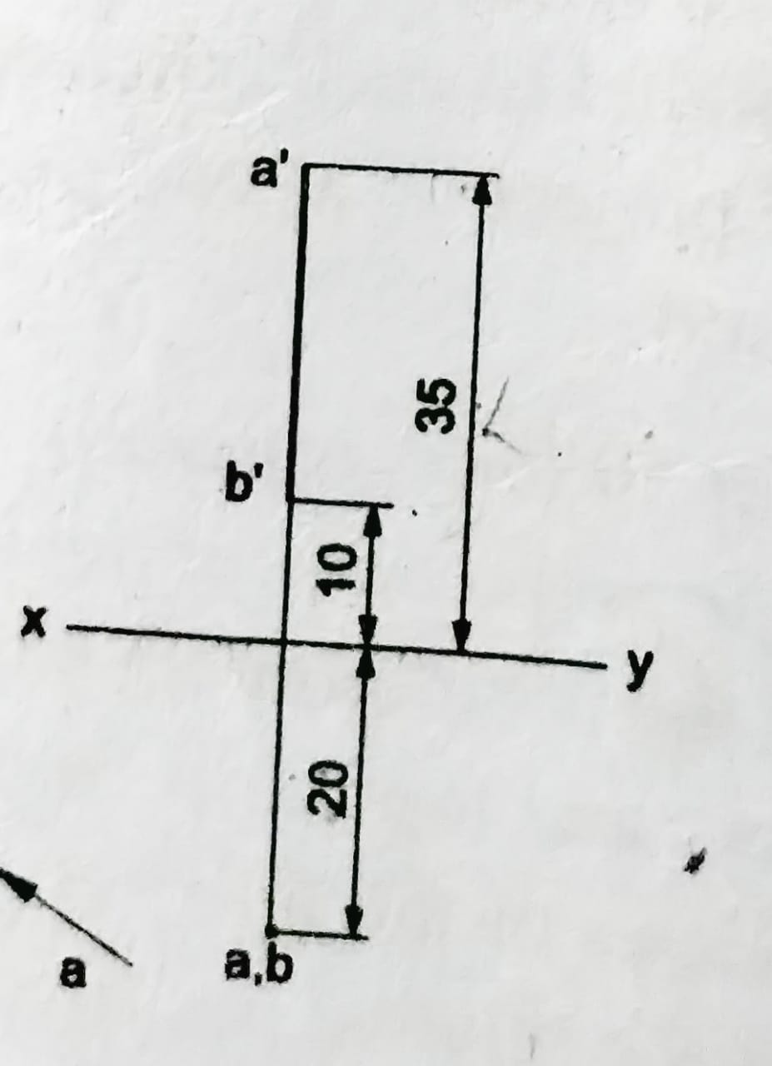
16. A line AB of 25 long, is perpendicular to H.P and parallel to V.P. The end points A and B of the line are 35 and 10 above H.P respectively. The line is 20 in front of V.P. Draw the projections of the line.

Slide 18
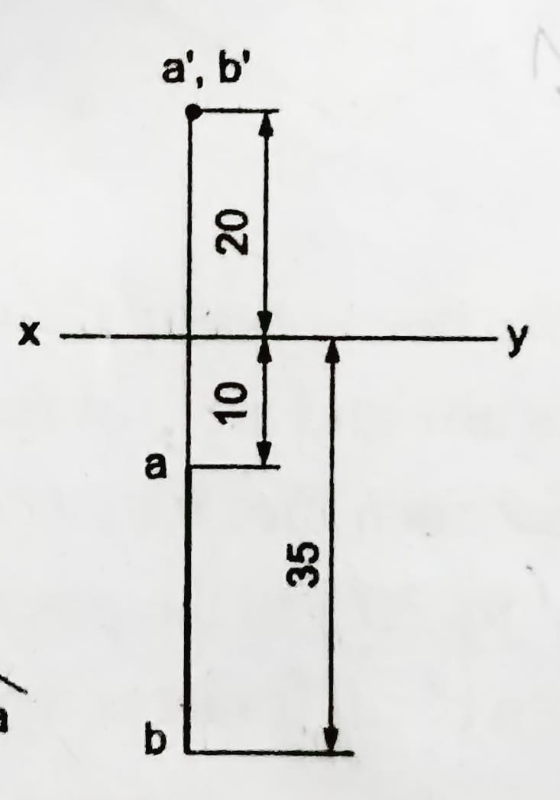
17. A line AB of 25 long, is perpendicular to V.P and parallel to H.P. The end points A and B of the line are 10 and 35 in front of V.P respectively. The line is 20 above H.P. Draw its projections.

Slide 19
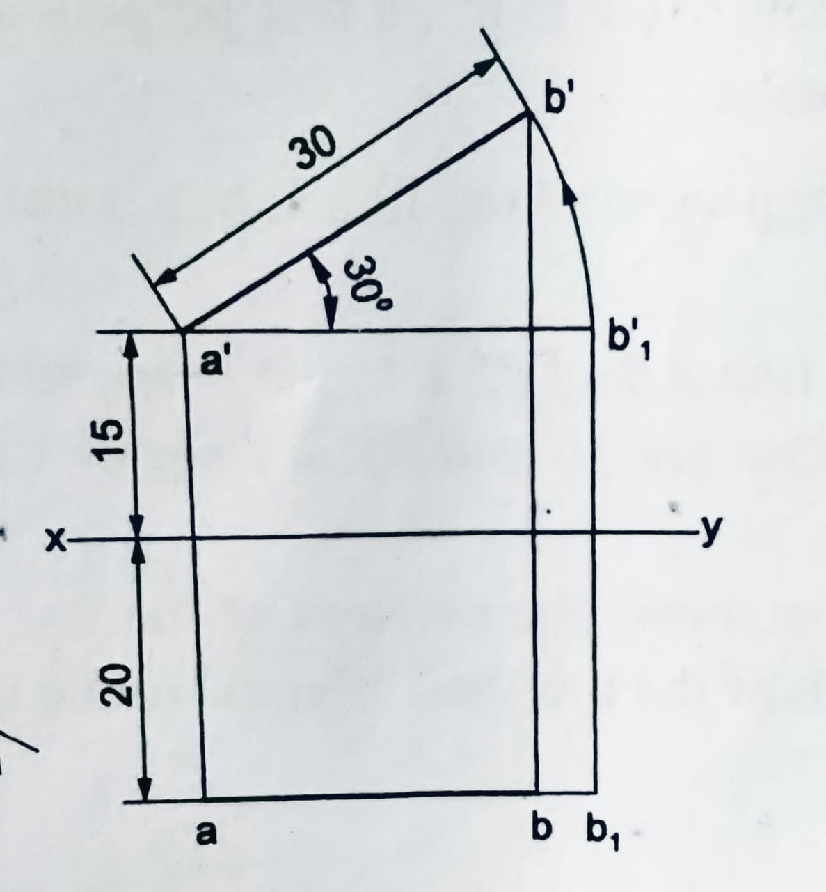
18. A line AB is 30 long and inclined at 30° to H.P. and parallel to V.P. The end A of the line is 15 above H.P and 20 in front of V.P. Draw the projections of the line.

Slide 20
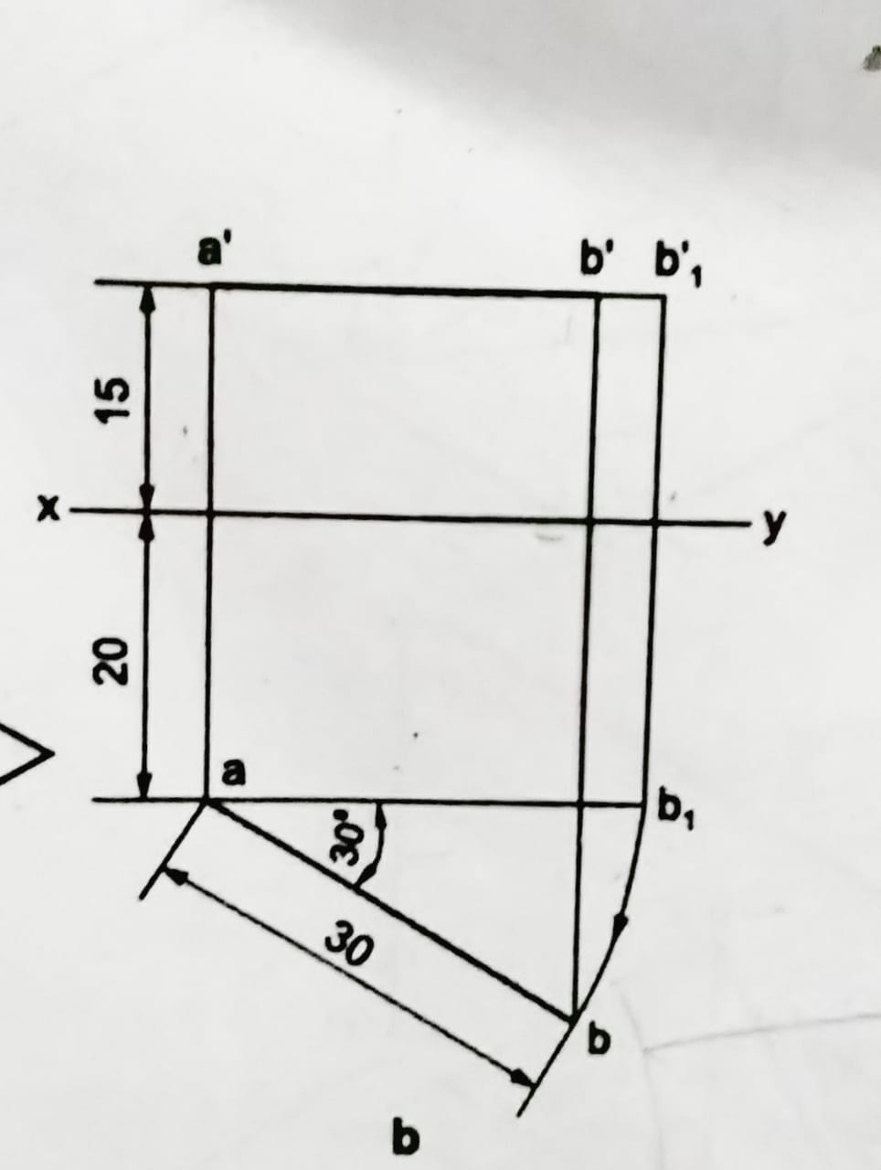
19. A line AB is 30 long and inclined at 30° to V.P and parallel to H.P. The end A of the line is 15 above H.P and 20 in front of V.P. Draw its projections.

Slide 21
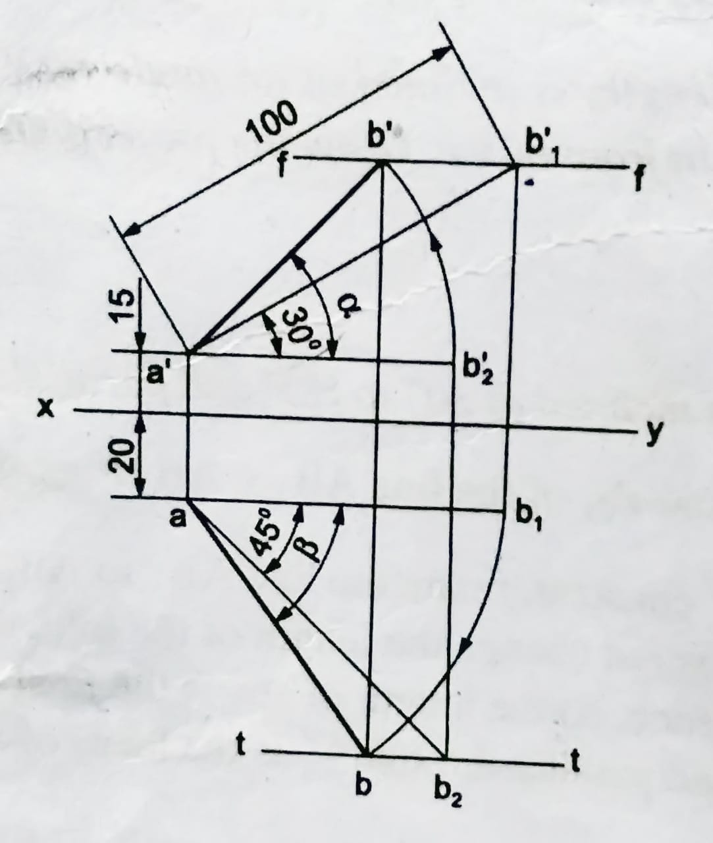
20. A line AB of 100 length, is inclined at an angle of 30° to H.P and 45° to V.P. The point A is 15 above H.P and 20 in front of V.P. Draw the projections of the line.

Slide 22
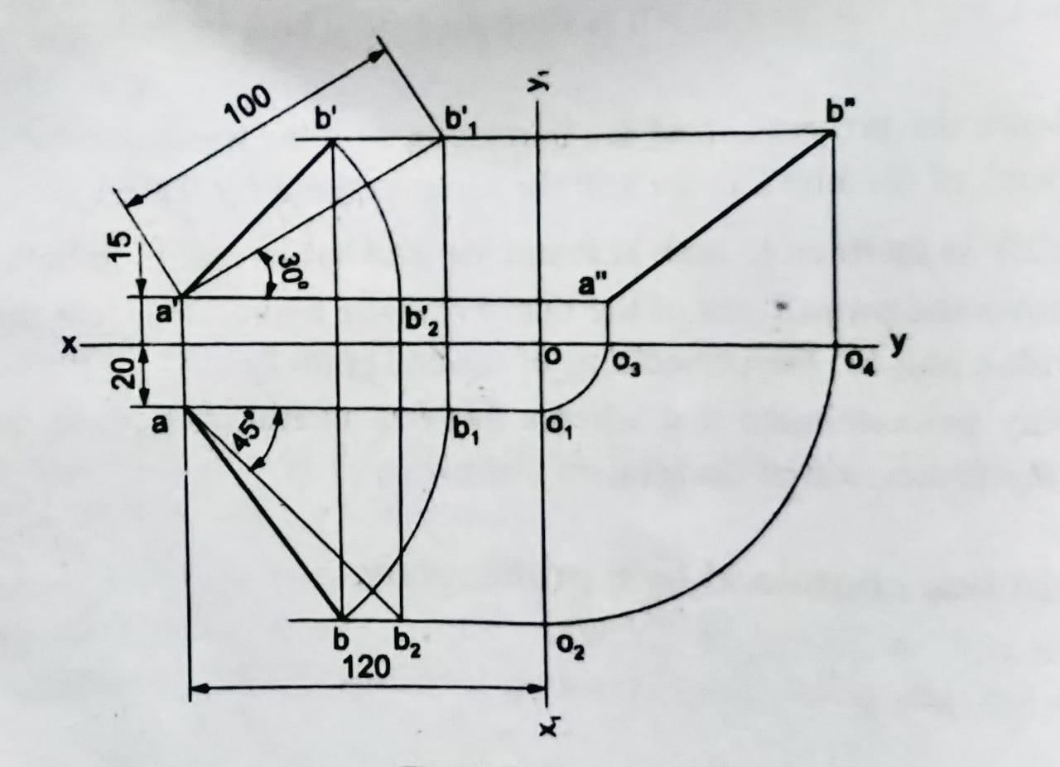
21. A line AB of 100 length is inclined at an angle of 30° to H.P and 45° to V.P. The point A is 15 above H.P, 20 in front of V.P and 120 from right profile plane (RPP). Draw (i) front view, (ii) top view and (iii) left side view of the line AB.

Slide 23
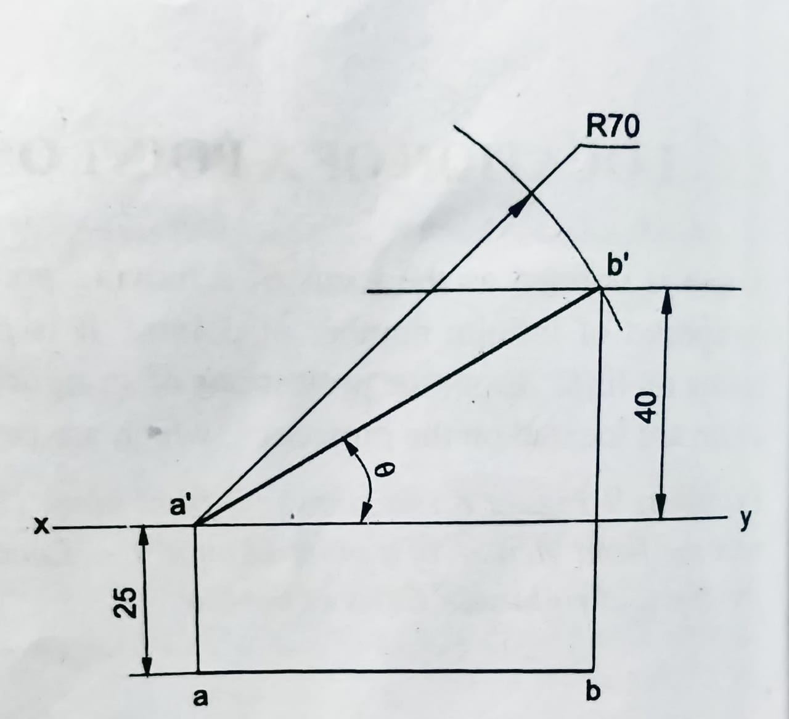
22. A line AB of 70 long, is parallel to and 25 in front of V.P. Its one end is on H.P while the other is 40 above H.P. Draw the projections of the line and determine its inclination with H.P.

Slide 24
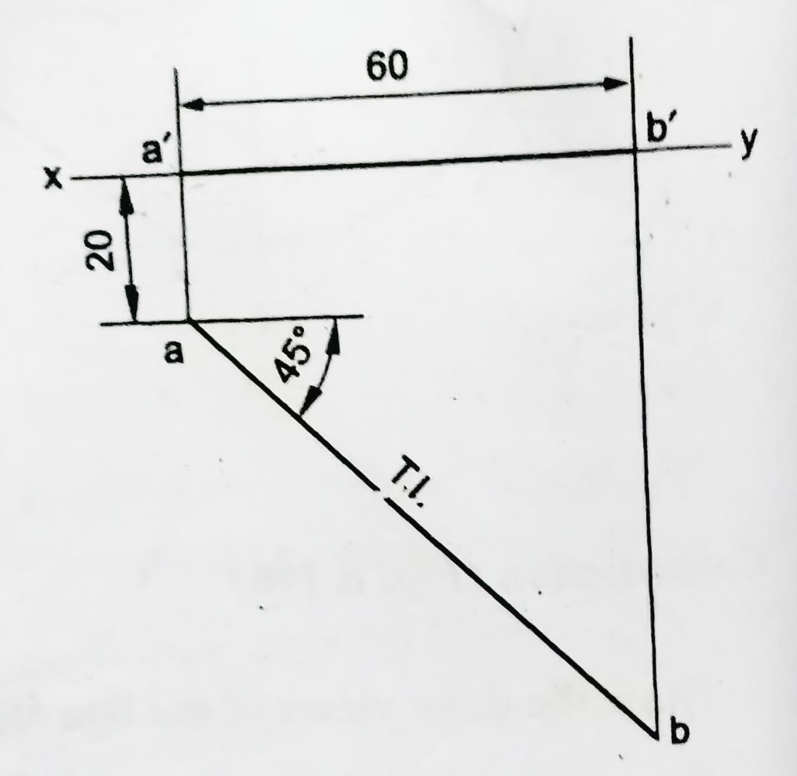
23. A line AB is on H.P and its one end A is 20 in front of V.P. The line makes an angle of 45° with V.P and its front view is 60 long. Draw the projections of the line and determine the true length.

Slide 25
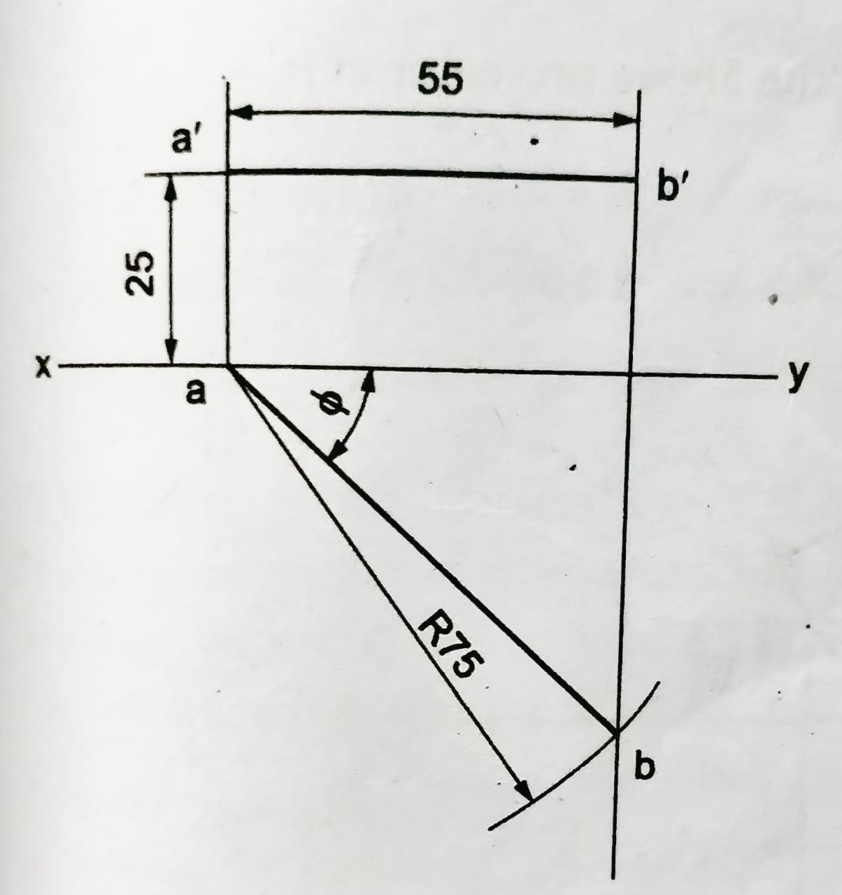
24. The front view of a 7.5 cm long line measures 5.5cm. The line is parallel to the H.P and one of its ends is in the V.P and 2.5 cm above the H.P. Draw the projections of the line and determine its inclination with V.P.

Slide 26
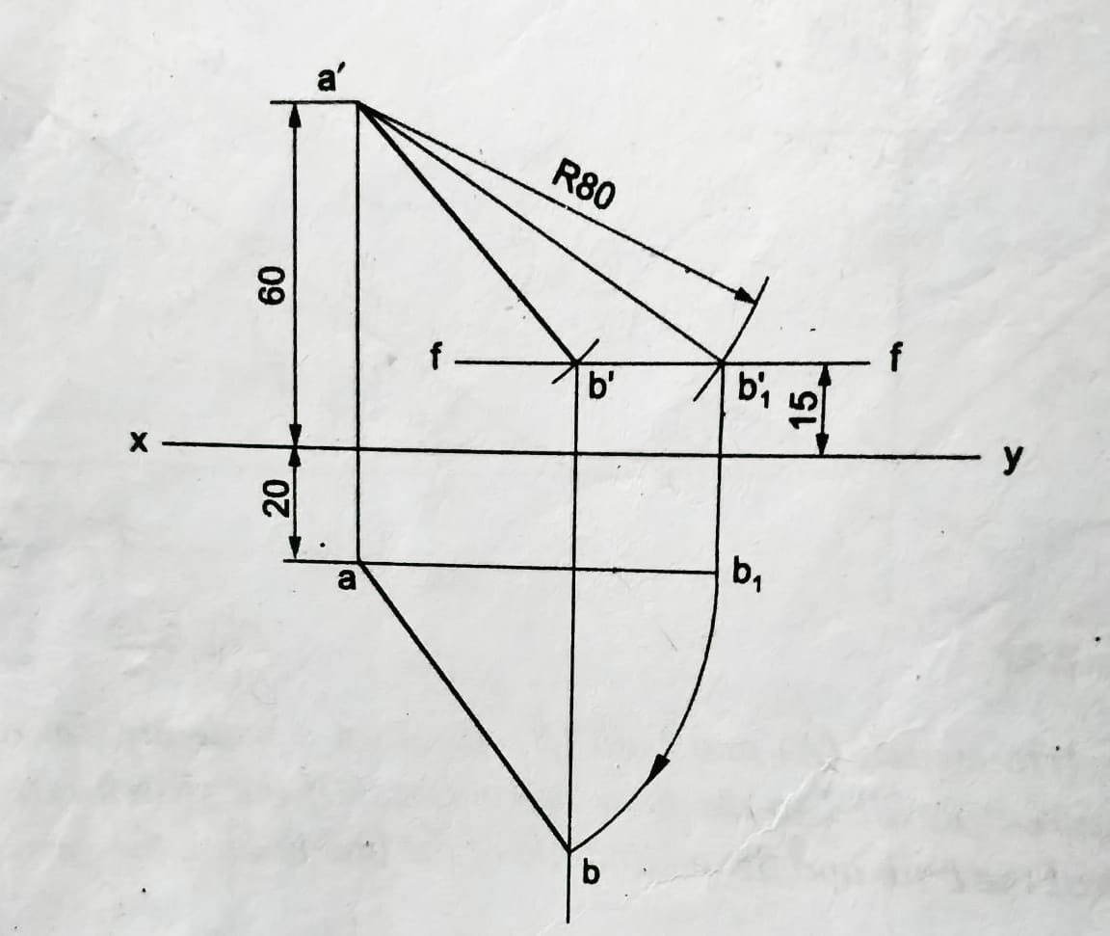
25. A line measuring 80 long has one of its ends 60 above H.P and 20 in front of V.P. The line is parallel to the H.P other end is 15 above H.P and in front of V.P. The front view of the line is 60 long. Draw the top view.

Slide 27
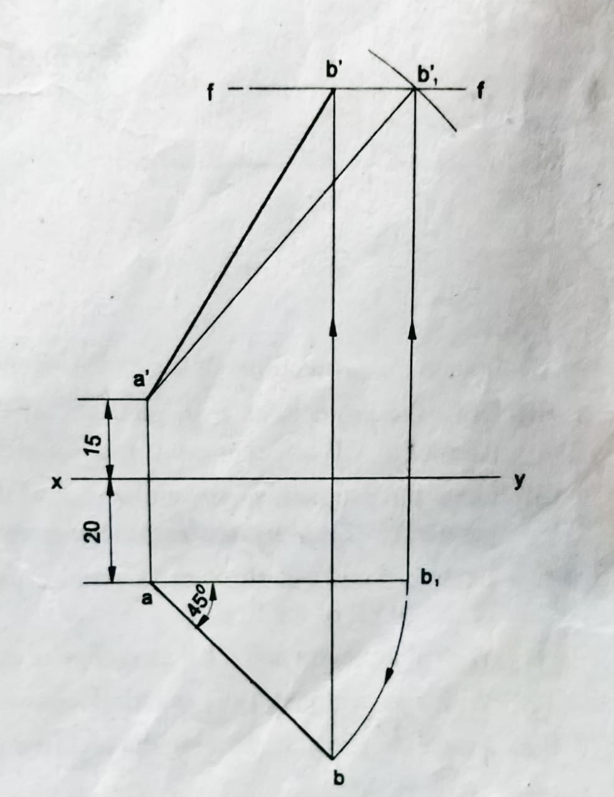
26. A line AB of 75 length has its end A 15 above H.P and 20 in front of V.P. The length of top view is 50 and the top view makes an angle 45° with xy. Draw the projections.

Slide 28
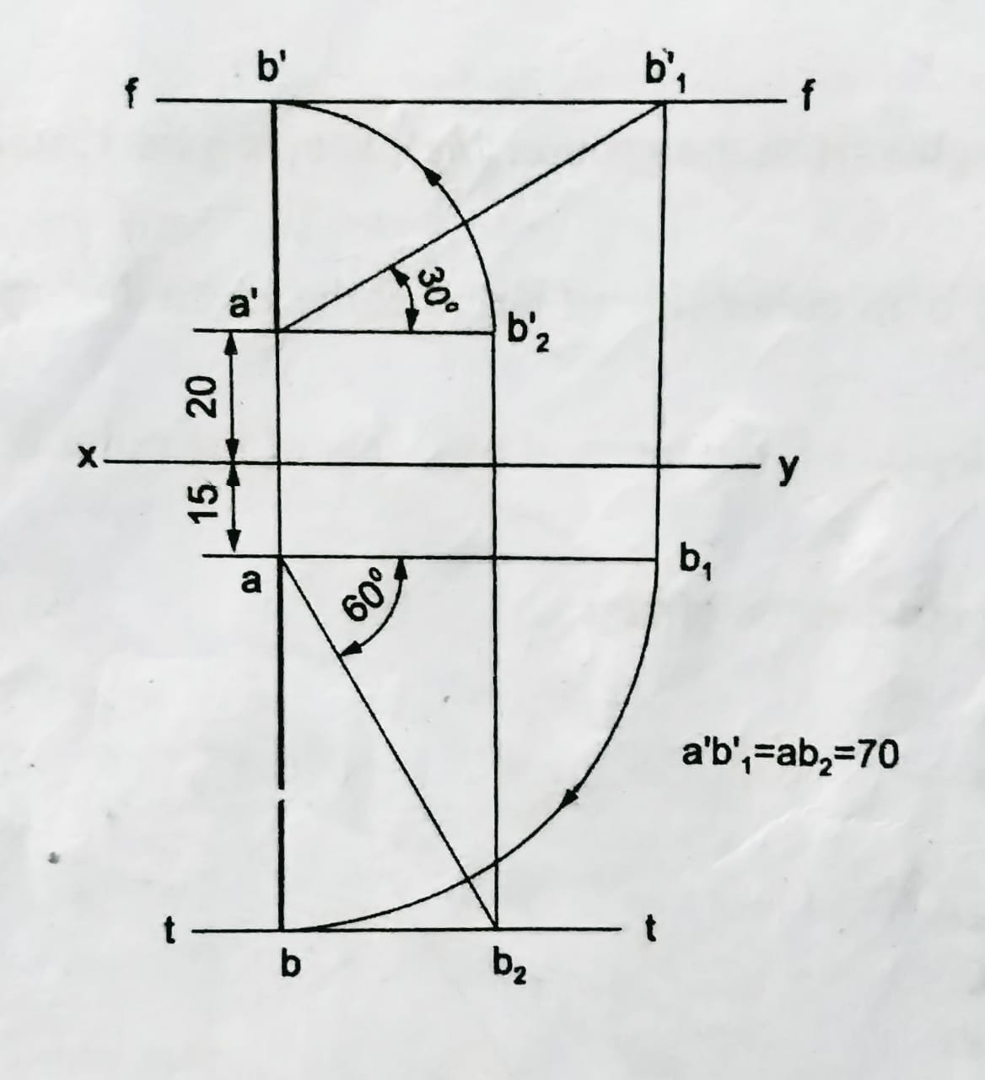
27. A line AB of 70 long, has its end A, 20 above H.P and 15 in front of V.P. The line is inclined at 30° to H.P and 60° to V.P. Draw its projections.

Slide 29
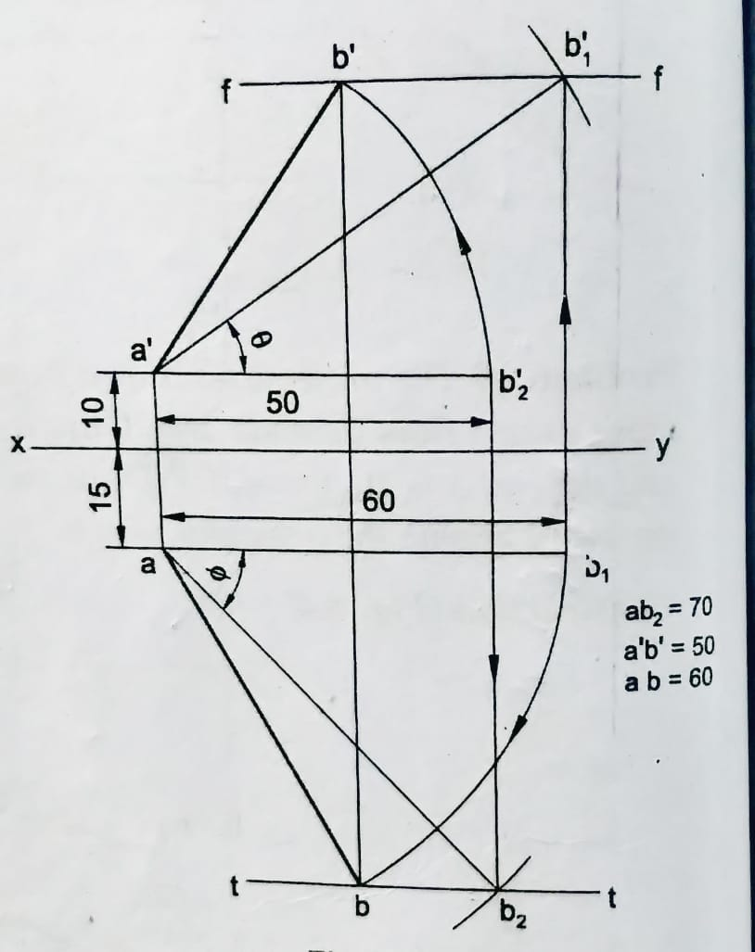
28. A line AB of 70 long, has its end A at 10 above H.P and 15 in front of V.P. Its front view and top view measure 50 and 60 respectively. Draw the projections of the line and determine its inclinations with H.P and V.P.

Slide 30
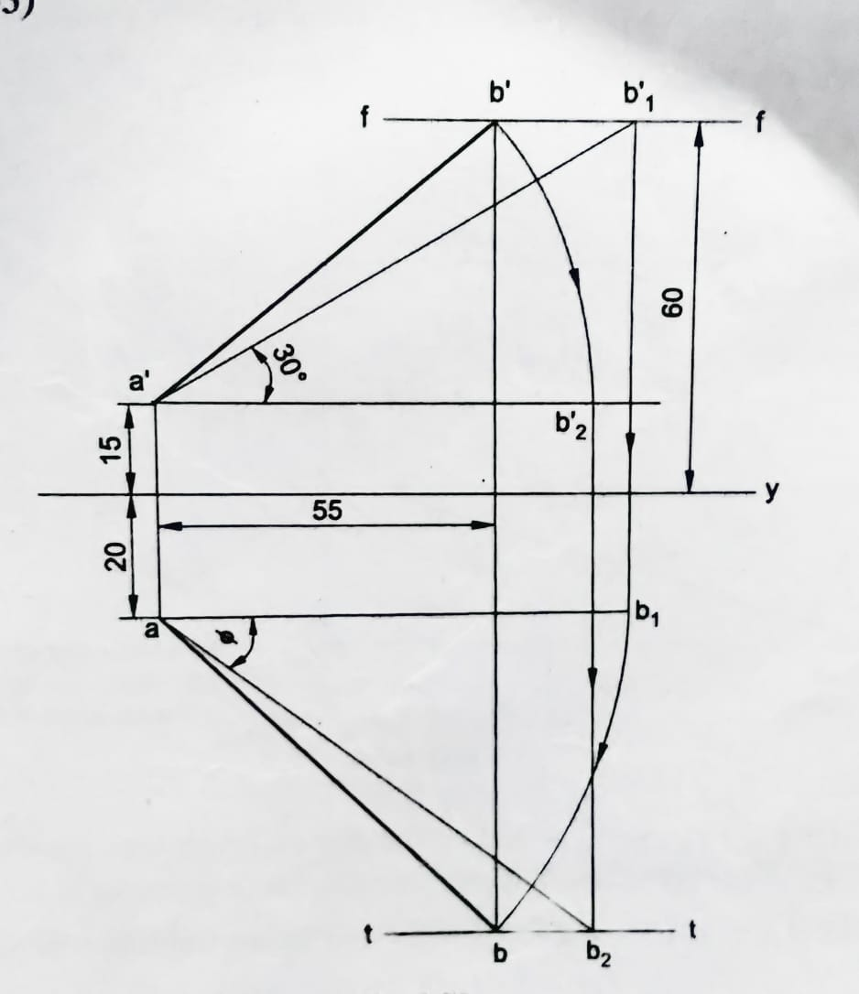
29. A line AB has its end A, 15 above H.P and 20 in front of V.P. The end B is 60 above HP and the line is inclined at 30° to H.P. The distance between the end projectors of the line is 55 Draw the projectors and find its inclination with V.P.

Slide 31
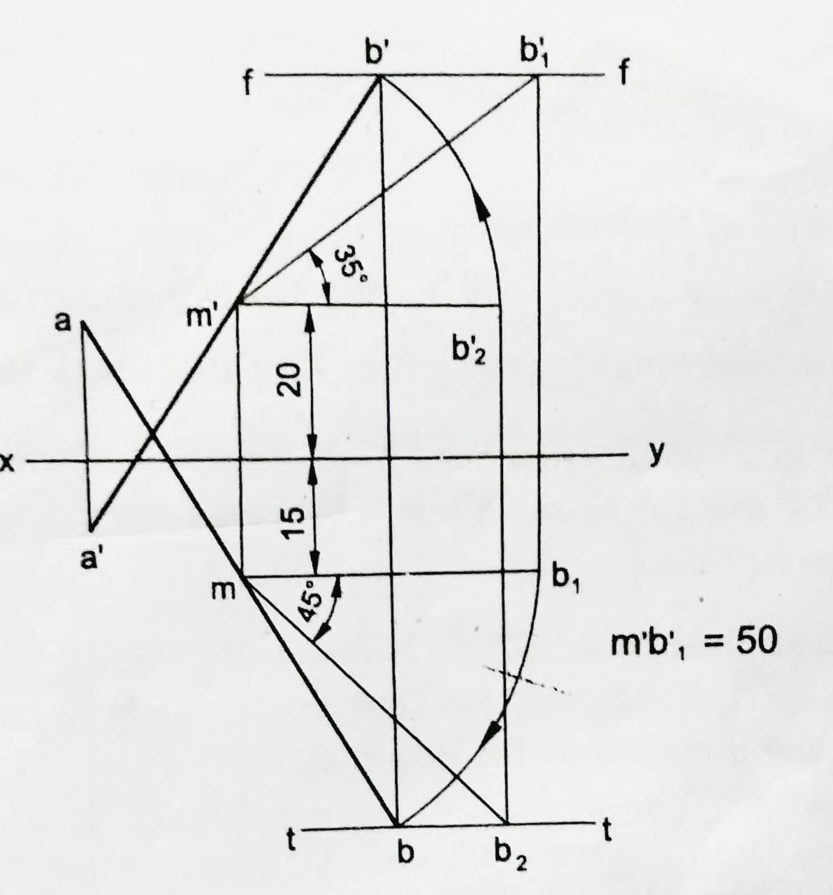
30. A line of 100 long, makes an angle of 35° with H.P and 45° with VP. Its mid-point is 20 above H.P and 15 in front of V.P. Draw the projections of the line.

